Slide 1
SELF ORGANISING MAPS(SOM)
BY TANISHQ JADHAV (3163038)

Slide 2
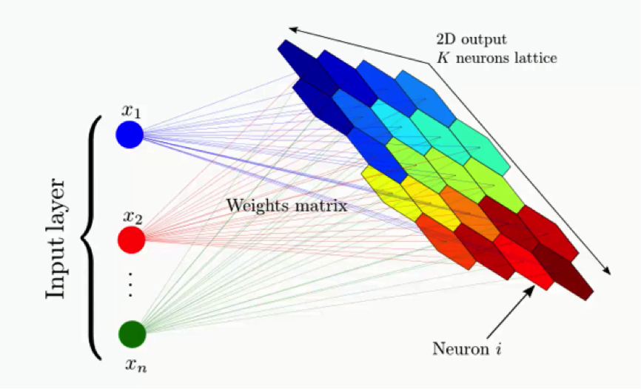
SELF ORGANISING MAPS ARE A PART OF UNSUPERVISED DEEP LEARNING ALGORITHMS.
SOMs ARE USED FOR FEATURE DETECTION AND REDUCING THE DIMENSIONS OF YOUR DATASET
SOM IS SIMILAR TO K-MEANS CLUSTURING FROM MACHINE LEARNING.
THE EXAMPLE SHOWS A COMPLEX DATA SET CONSISTING OF A MASSIVE AMOUNT OF COLUMNS AND DIMENSIONS AND DEMONSTRATES HOW THAT DATA SET’s DIMENSIONALITY CAN BE REDUCED.

Slide 3
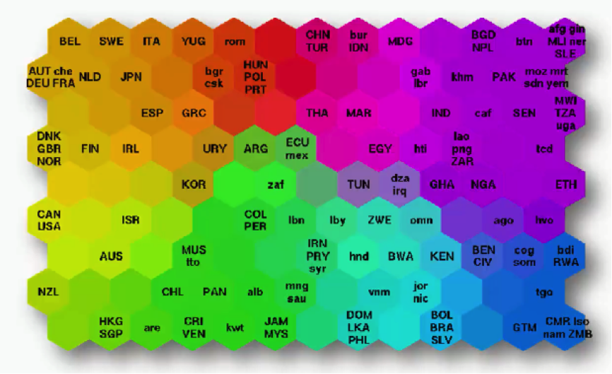
What you see below is an actual SOM. This map represents the levels of economic wellbeing across a wide range of countries.
As you can see, the countries are lined up in a cluster, and their order inside that cluster is based on various indicators (e.g. health conditions, quality of education, average income per capita, etc.).

Slide 4
HOW DO SELF ORGANISING MAPS LEARN?

Slide 5
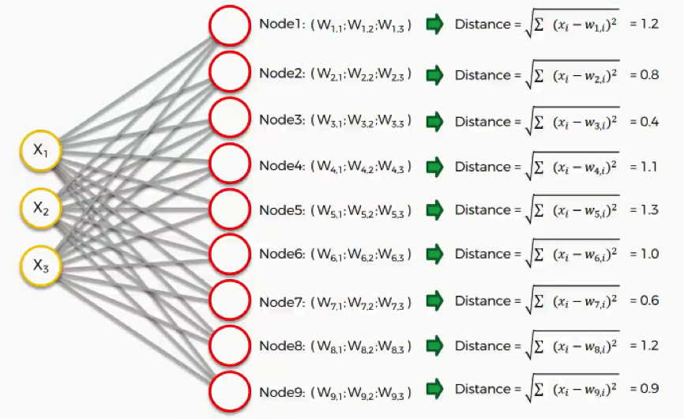
Our input vectors amount to three features, and we have nine output nodes. WITH SOM THERE IS NO ACTIVATION FUNCTION. The next step is to go through our dataset. For each of the rows in our dataset, we'll try to find the node closest to it. As we can see, node number 3 is the closest with a distance of 0.4. We will call this node our BMU (best-matching unit).

Slide 6
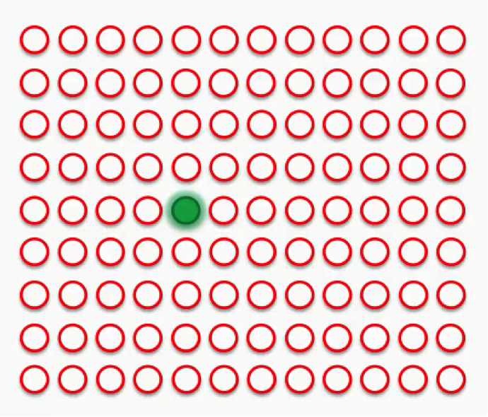
The green circle in the figure above represents this map's BMU. Now, the new SOM will have to update its weights so that it is even closer to our dataset's first row.
The reason we need this is that our input nodes cannot be updated, whereas we have control over our output nodes.

Slide 7
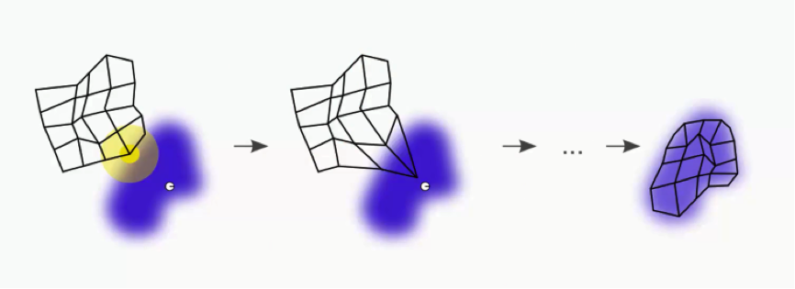
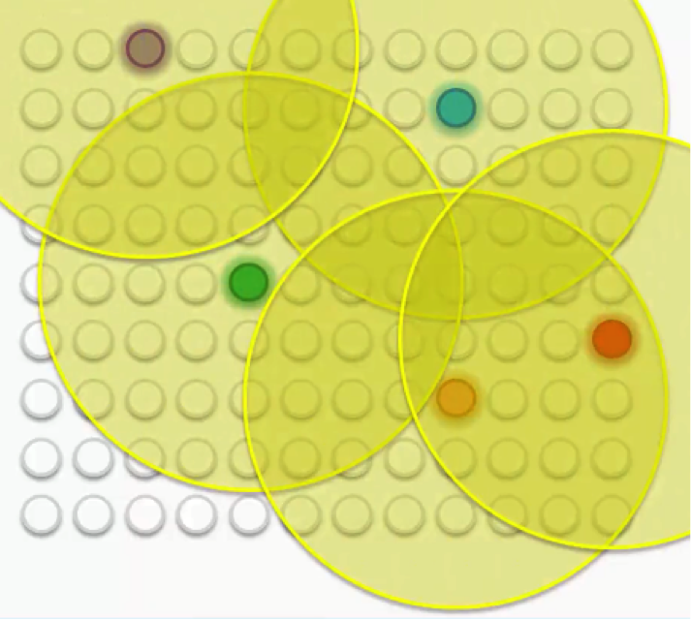
In simple terms, our SOM is drawing closer to the data point by stretching the BMU towards it. The end goal is to have our map as aligned with the dataset as we see in the image on the far right.
Our map this time will contain multiple best-matching units (BMUs) instead of just two.
Then each of these BMUs will be assigned a radius like in the image below.
Let's examine these BMUs one by one. Take the purple node at the top-left. It has been updated so as to be brought closer to the row with which it matches up. The other nodes that fall into its radius undergo the same updates so that they're dragged along with it.

Slide 8
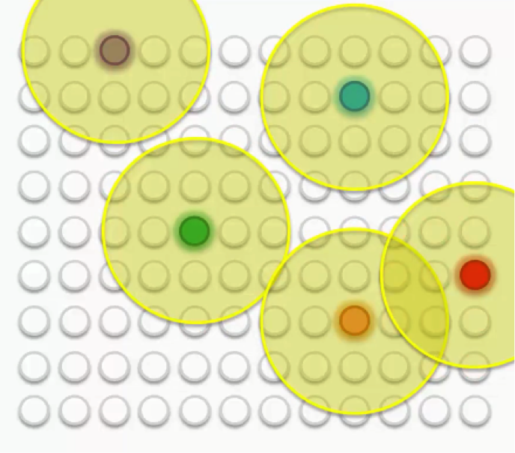
As we repeat this process going forward, the radius for each BMU shrinks. That's a unique feature of the Kohonen algorithm.
That means that each BMU will start exerting pressure on fewer nodes.
As we proceed, we move from trying to merely let our BMUs touch the data points to trying to align the entire map with the dataset with more precision.

Slide 9
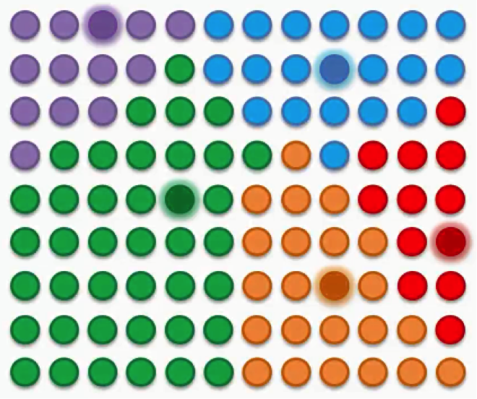
In visual terms, that would lead us to a map that looks something like this.
After all the push and pull between the nodes and the different BMUs, we have come to a point where each node has been assigned a BMU.

Slide 10
There are a few points to bear in mind here:
SOMs retain the interrelations and structure of the input dataset.
SOMs uncover correlations that wouldn't be otherwise easily identifiable.
SOMs categorize data without the need for supervision.
SOMs do not require target vectors nor do they undergo a process of backpropagation.
There are lateral connections between output nodes.

Slide 11
APPLICATIONS OF SOM
The "Clusters" SOM is based on the sum of all the votes on all these different issues, and so it's very likely to find members of the Democratic Party siding with the Republicans and vice versa.
The Unified Distance Matrix, or the U-matrix, represents the distances between the points or nodes on the SOM. The dark parts in that matrix represent the parts of the map where the nodes are far away from each other, and the lighter parts represent less distances between the nodes.
Bankruptcy/Abuse Prevention. SOMs make it possible for you to visually detect these deviations without having to monitor all the data.
Border Protection/Anti-Terrorism
Broadcast Decency Enforcement

